Slide 1
Discrete time Quantum Random Walk
Under guidance of
Proff : Jaydeep Mulhekar

Slide 2
Outline
Introduction
DTQRW for 2D
What have we done
What have we learnt
Uses of 4D - DTQRW
References

Slide 3
Introduction
In the fields of quantum computing and quantum information theory, quantum random walks (QRWs) have emerged as a strong paradigm. They serve as a quantum counterpart to conventional random walks and have found applications in a variety of fields, including algorithm creation, quantum search, and optimisation challenges. QRWs are an attractive subject to investigate due to their intrinsic quantum parallelism and interference features.
In recent years, researchers have extended the concept of QRWs from traditional 1D and 2D systems to higher dimensions, unlocking a whole new realm of possibilities. Among these extended models, the Discrete Time Quantum Random Walk in 4 Dimensions (4D-DTQRW) holds particular significance due to its potential applications in quantum simulation, complex network analysis, and quantum communication.

Slide 4
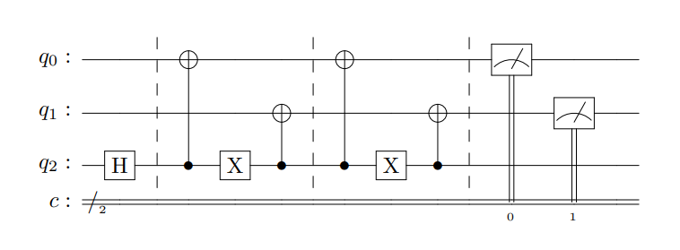
1 particle DTQRW for 2D cube
Qubits q0 and q1 represents position space of the particle
Qubit q2 represents the coin space of the particle
The Quantum Circuit for 1 particle DTQRW on 2D cube

Slide 5

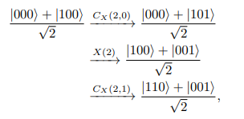
1 particle DTQRW for 2D cube
The system is initialized to (H ⊗ I ⊗ I) |000⟩, where I is the identity operator. Since,
the system is thus initialized to |D⟩ |00⟩.
The application of U to this initial state evolves the system to the quantum state ( |110⟩+|001⟩ ) / √2 as shown below.

Slide 6
What have we done
We have developed a sophisticated program that utilizes the qiskit library of the Python programming language. This program has been designed specifically to implement a quantum circuit for the 2-particle DTQRW (Discrete Time Quantum Random Walk) on a 4-dimensional hypercube.
One of the unique features of our program is that it makes use of an entangled coined space for both particles. This means that the two particles are linked together in a way that allows them to share information and interact in a highly complex manner. By incorporating this feature into our program, we are able to perform more advanced calculations and simulations than would be possible with a non-entangled system.
The 4-dimensional hypercube is a particularly challenging space to work in because it requires a high degree of precision and accuracy. However, with our program, researchers and scientists are able to explore this space with greater ease and efficiency. This represents a significant advancement in the field of quantum computing and has the potential to lead to new breakthroughs in a wide range of industries and scientific fields.

Slide 7
What have we learnt
Learnings from this project:
The qiskit library of the Python programming language is a powerful tool for developing quantum computing programs.
The implementation of a quantum circuit for the 2-particle DTQRW on a 4-dimensional hypercube can be a challenging but rewarding task.
The use of an entangled coined space for both particles can lead to more advanced calculations and simulations.
Precision and accuracy are crucial when working with complex quantum systems in high-dimensional spaces.
Advancements in quantum computing have the potential to revolutionize many industries and scientific fields, leading to new breakthroughs and discoveries.

Slide 8
Uses of 4D-DTQRW
Quantum Simulation: Quantum random walks in higher dimensions can be employed for simulating complex quantum systems, offering advantages over classical simulation methods. By mapping the behavior of quantum particles onto the 4D lattice, researchers can simulate quantum processes that are difficult or infeasible to study using classical computers. This has implications for understanding quantum phase transitions, quantum field theories, and other quantum phenomena.
Quantum State Transfer: Quantum random walks have been explored as a means for quantum state transfer between distant qubits in a quantum computing architecture. In 4D-DTQRW, the potential for multi-dimensional state transfer opens up new possibilities for efficient and robust quantum communication protocols.

Slide 9
References
IMPLEMENTATION OF QUANTUM HITTING TIMES OF CUBELIKE GRAPHS ON IBM’S QISKIT PLATFORM
Quantum walk on a line with two entangled particles
Quantum Walks on the Hypercube

Slide 10
Contributions
202001023 - Vandan Patel | Python programme using Qiskit library to implement quantum circuit of 2 particle 4D-DTQRW for entangled coin space.
202003036 - Pratap Ratiya | Theoretical calculations for first 2 steps of 2 particle 4D-DTQRW for entangled coin space.

